Slide 1
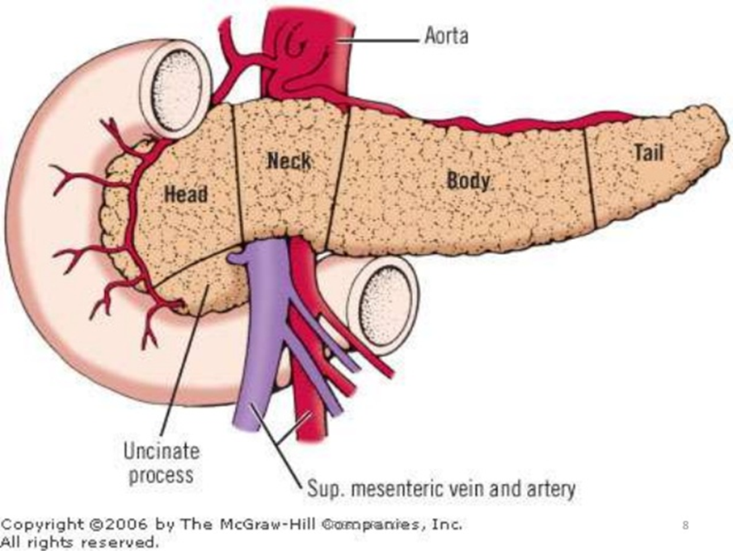
PANCREAS -2 DISORDER
DR. SHEETAL JAIN

Slide 20
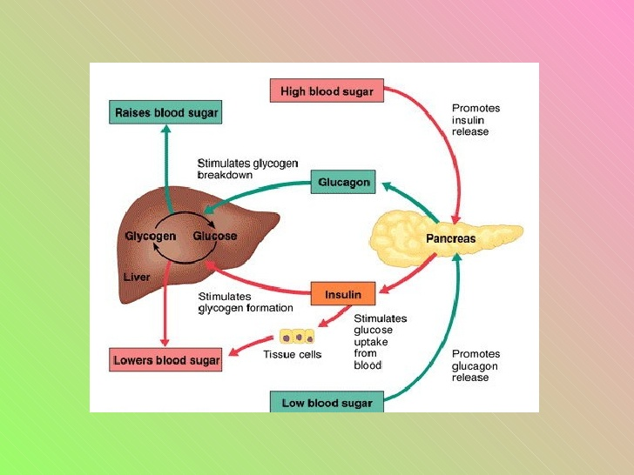

Slide 47
THANKS

