Slide 1
GLOBALIZATION
ITS IMPACT ON HUMAN RESOURCE

Slide 2

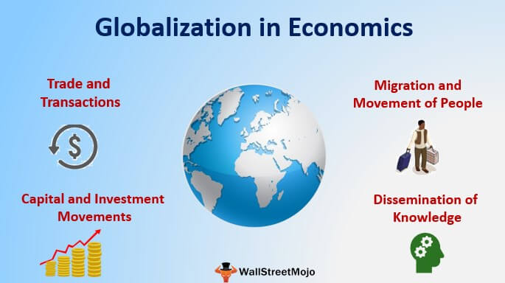
GLOBALIZATION

Slide 3
introduction
Have you ever thought what if things like whatsapp, Facebook, Gmail and all other means of connectivity available today, could have existed in earlier centuries ? How would the entier international trade, people, good and supplies would have been sold and bought ??
Or how effcient would people like Subhas Chandra Bose, Hitler, Mahatma Gandhi etc be, if only they had Mobiles, Tablets, Laptops, Desktops to check news updates, whether conditions, radios frequencies etc to overcome the hurdles while fighting for our Independence.
This is what we call going ahead with Globalization Like using a laptop which is manufactured in USA, or having a chocolate which comes from Belgium.

Slide 4
GLOBALIZATIN : MEANING
GLOBALIZATION :
MEANING : Globalization is the word used to describe the growing interdependence of the world’s economies, cultures, and populations, brought about by cross-border trade in goods and services, technology, and flows of investment, people, and information. Countries have built economic partnerships to facilitate these movements over many centuries.
But the term gained popularity after the Cold War in the early 1990s, as these cooperative arrangements shaped modern everyday life.

Slide 5
Drivers of globalization :
GATT : General Agreement on tariff and trade : was a multilateral agreement regulating international trade.
EUROPEAN UNION (EU) : It is a Politico Economic Union of 27 member states.
NAFTA : The North American Free Trade Agreement- creating one of the world’s largest free trade zones and laying the foundations for strong economic growth.
ASEAN : The Association of South East Asian Nations- it is an alliance promoting economic and political cooperation by fostering dialogue among its members.
BRICS :BRICS is the group composed by the five major emerging countries - Brazil, Russia, India, China and South Africa -, which together represent about 42% of the population, 23% of GDP, 30% of the territory and 18% of the global trade.
SAARC : The South Asian Association of Regional Cooperation (SAARC) was created in 1985 as an expression of the region's collective decision to evolve a regional cooperative framework. Presently, there are eight member countries in SAARC namely Afghanistan, Bangladesh, Bhutan, India, Nepal, Maldives, Pakistan and Sri Lanka.

Slide 6
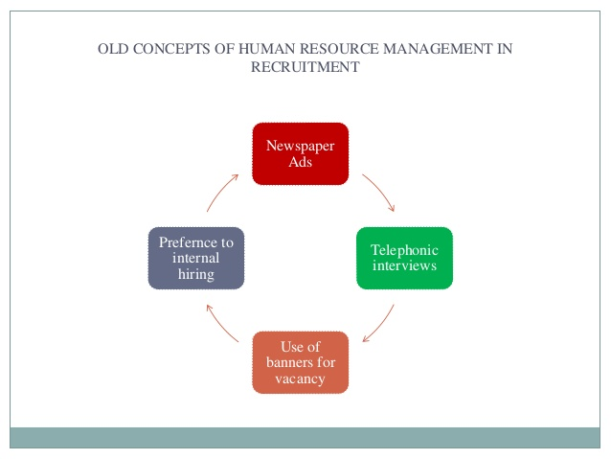
Old concepts of human resource management in recruitment

Slide 7
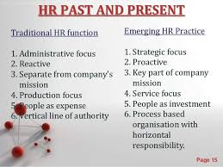
HUMAN RESOURCE

Slide 8
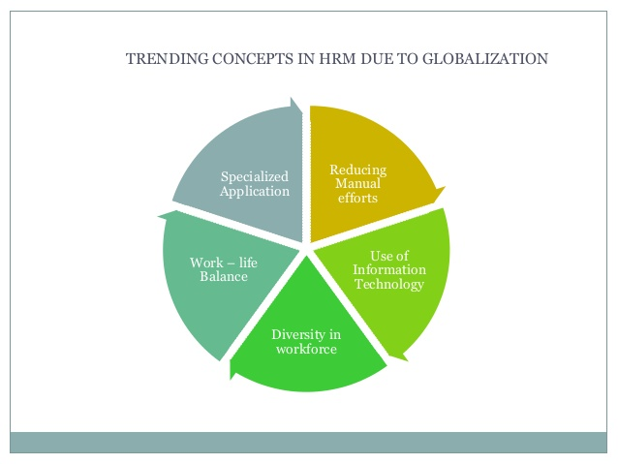

Slide 9
Globalization and its impact on HR
Impact of Globalization on Human Resource :
Globalization of Human Capital
Corporate and Cultural Differences
Employment and Tax Laws
Long-Distance Communication Challenges

Slide 10


