Slide 1
burlesque

Slide 2
What is burlesque?
Burlesque is a comic style that works in one of two ways: you can either elevate something lowly and ridiculous (high burlesque) or trivialize something lofty and important (low burlesque).
Burlesque makes audiences laugh because of the difference between the content and the form (the style and the substance).
A burlesque is a performance or a piece of writing that makes fun of something by copying it in an exaggerated way.

Slide 3
Types of burlesque
High Burlesque
Low Burlesque

Slide 4
High burlesque
High Burlesque occurs when the form and style of the piece are dignified and “high,” or “serious” while the subject matter is trivial or “low.”
Types of high burlesque include
the “mock epic” or “mock-heroic” poem
the parody.

Slide 5
Mock-heroic poem
It imitates the generally complicated and elaborate form of the epic poem, and it also imitates that genre’s rather formalized style. In so doing, however, it applies this “high” form and style to rather ordinary or insignificant topics. A significant example of a mock epic is Alexander Pope’s The Rape of the Lock (1714), which is elegant and elaborate in style, but which, on its surface, has only a lady’s curl as its subject.
But trust the Muse — she saw it upward rise, Tho' mark'd by none but quick, poetic eyes: A sudden Star, it shot thro' liquid air,
And drew behind a radiant trail of hair.

Slide 6
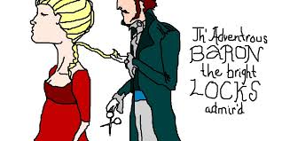
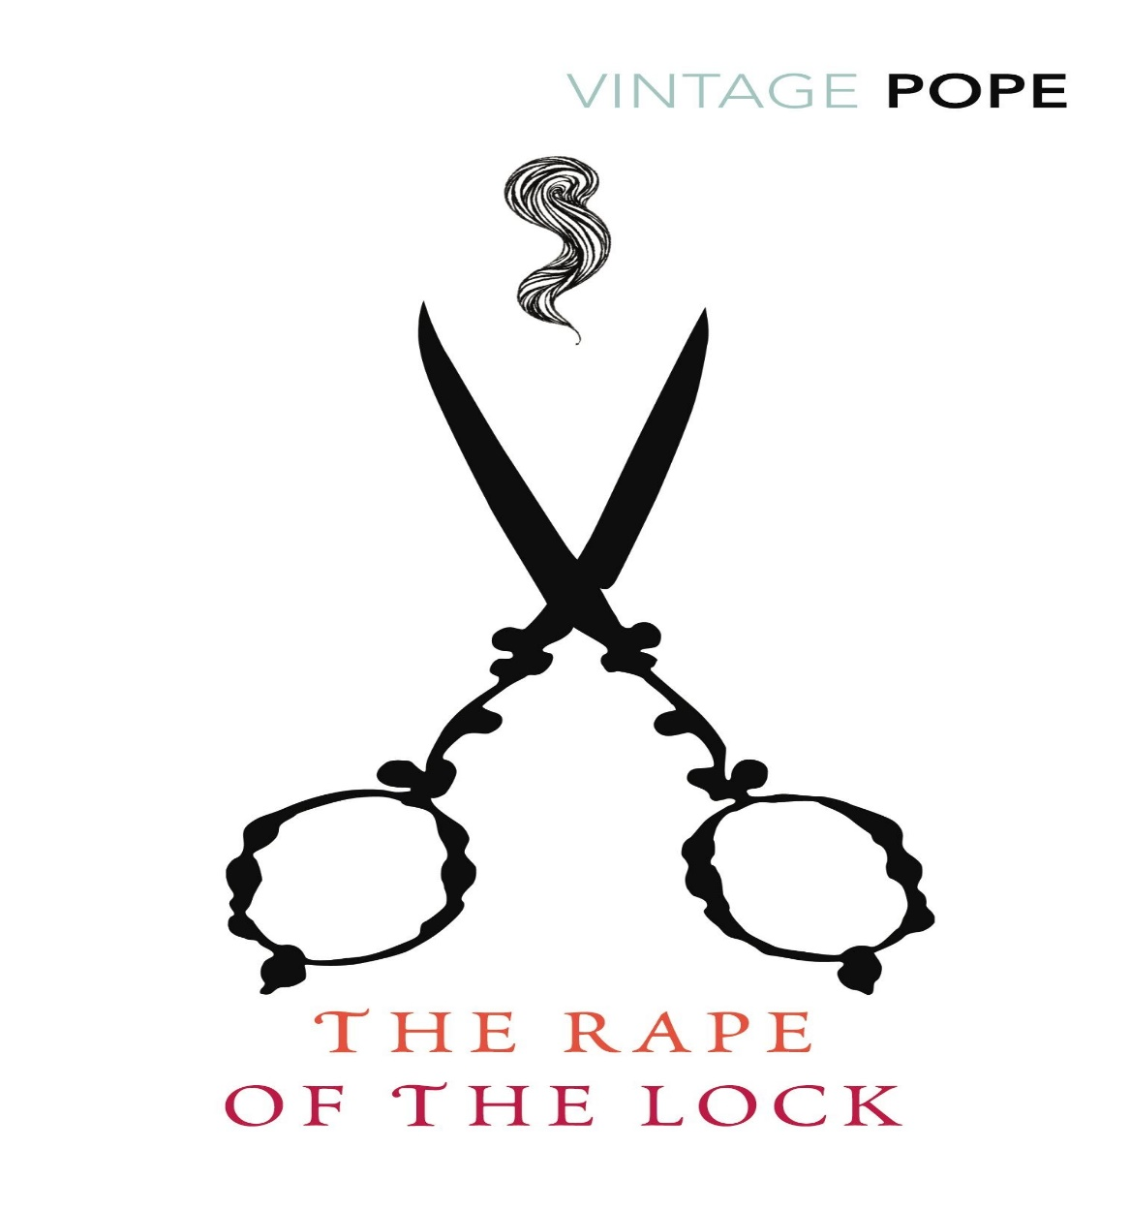

Slide 7
parody
A parody is an imitation of a writer, artist, subject, or genre in such a way as to make fun of or comment on the original work. Parodies are often exaggerated in the way they imitate the original in order to produce a humorous effect. While parodies are generally intended to amuse, they are not always comic in nature and sometimes take on fairly serious subject matters.
Parody treats with one author, style, or genre in which it subtly uses and then distorts or subverts the conventions of the original. An audience must understand the original off which a parody is written to fully “get the joke.”
Charlie Chaplin impersonated Hitler in the film The Great Dictator.
Shamela, as it is more commonly known, is a satirical burlesque novella by English writer Henry Fielding.

Slide 8
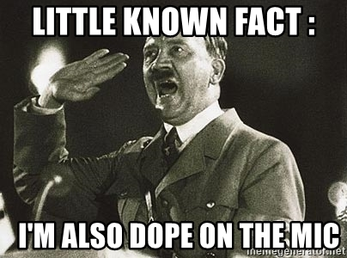
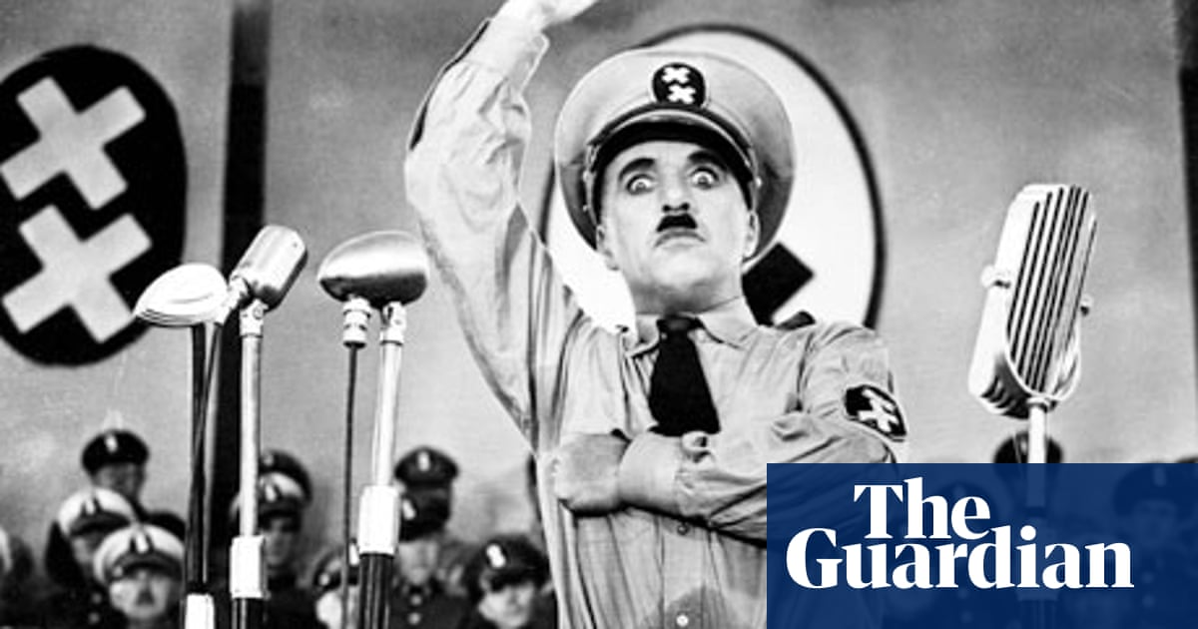

Slide 9
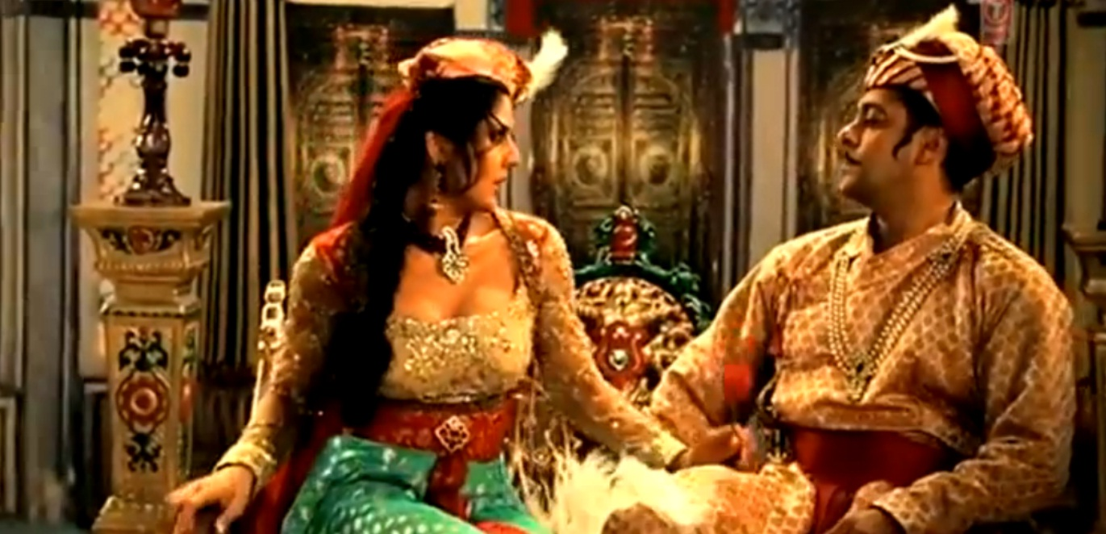

Slide 10
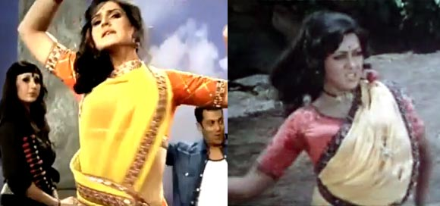
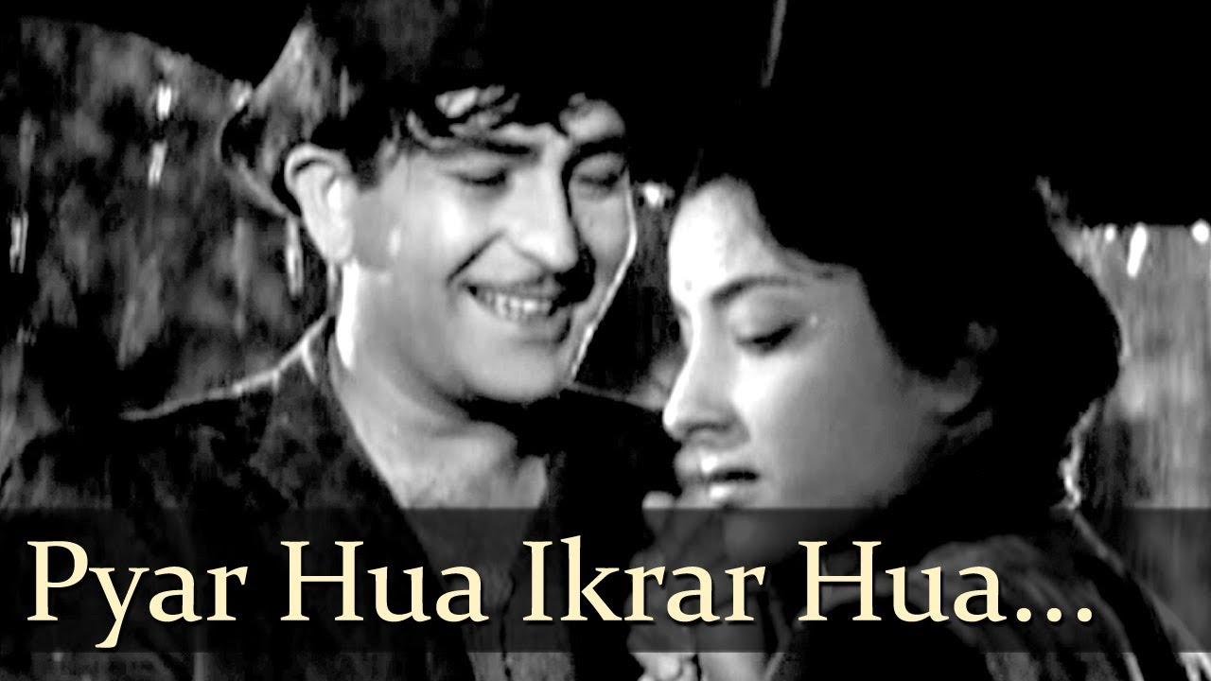
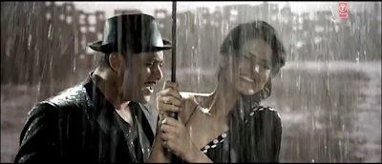

Slide 11
Low burlesque
Low Burlesque occurs when the style and manner of a work are low or undignified but, in contrast, the subject matter is distinguished or high in status.
The types of low burlesque include
Travesty
Hudibrastic poem
Lampoon
Caricature

Slide 12
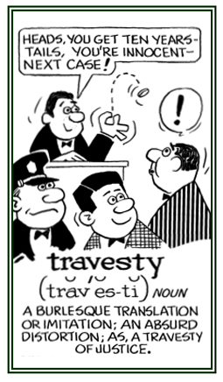
travesty
A travesty will mock a “lofty” or serious work
by treating the high subject in a grotesque and
undignified manner and (or) style.
Travesty is a crude form of burlesque
in which the original subject matter is
changed little but is transformed
into something ridiculous through
incongruous language and style.

Slide 13
caricature
A caricature is a rendered image showing the features of its subject in a simplified or exaggerated way through sketching, pencil strokes, or through other artistic drawings.
In literature, a caricature is a description of a person using exaggeration of some characteristics and oversimplification of others.

Slide 15
lampoon
Lampoon is a form of satire that is particularly biting and specific to a person or thing. Lampoon is often more than just satirizing a person or an institution; it is more of a specific attack. While satire might address general social behaviors, fashions, or groups; lampoon attacks a specific person, institution, or social construct.
The popular television show Saturday Night Live often satirizes political topics, but they lampoon specific political figures. They have performed particularly specific and biting skits about Hillary Clinton, Donald Trump, and George W. Bush just to name a few. These skits highlight the absurdity of some of the doublespeak or hypocrisy of these politicians.

Slide 16
Hudibrastic poem
The Hudibrastic poem is so-named for Samuel Butler’s Hubidras (1663). Butler turns the chivalric romance on its head, inverting the dignified style of that genre in order to present a hero whose travels were mundane and often humiliating. The Hudibrastic poem might also employ colloquialisms and other examples low style, such as the doggerel verse, in place of traditionally high style elements.

Slide 17
THE END

