Slide 1

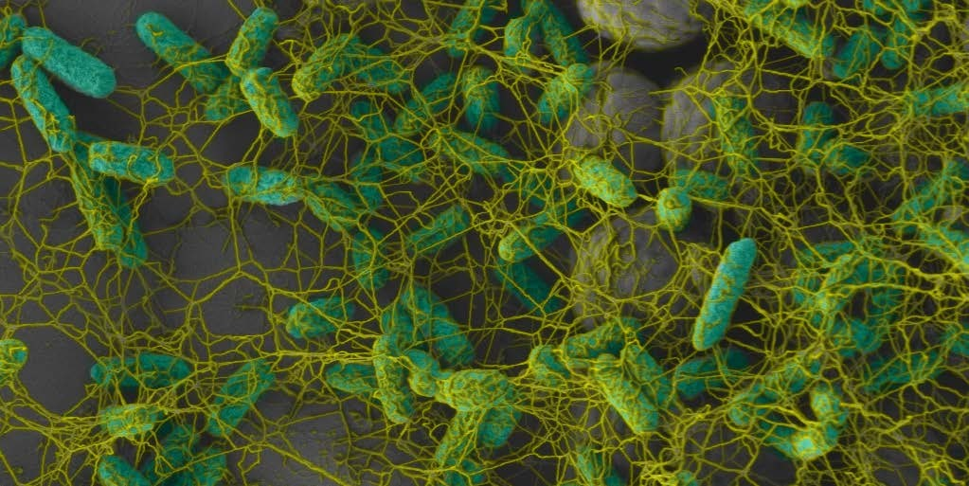





Slide 2
DEFINITION
Biofilm is a mode of microbial growth where dynamic communities of interacting sessile(organism fixed in pone place) cells are irreversibly attached to a solid substratum, as well as each other, and are embedded in a self made matrix of extracellular polymeric substance (EPS). - Ingle
Biofilm is defined as a community of microcolonies of microorganisms in an aqueous solution that is surrounded by a matrix of glycocalyx, which also attaches the bacterial cells to a solid substratum. - Grossman
2

Slide 3
Biofilms are likely to represent a natural scenario for bacterial communication.
(Davey and O’Toole, 2000)
A microbial biofilm is considered a community that meets the following four basic criteria:
Must possess the abilities to self-organize (Autopoiesis)
Resist environmental perturbations (Homeostasis)
Must be more effective in association than in isolation (Synergy)
Respond to environmental changes as a unit rather than (Communality).
single
individuals
3

Slide 4
Biofilms are characterized by
  Surface attachment
  Extracellular matrix of polymeric substances
  Structural heterogenicity
  Genetic diversity
  Complex community interactions
4

Slide 5

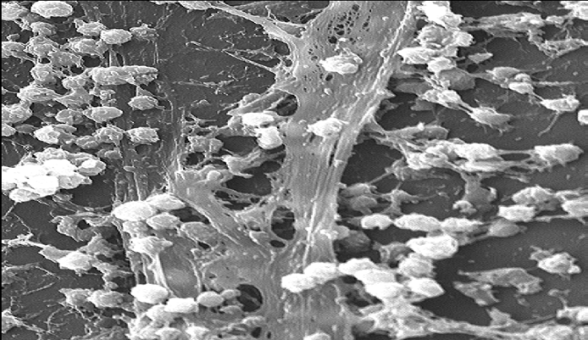
Biofilms grow virtually everywhere, in almost any environment where there is a combination of :
  Moisture
  Nutrient supply
  Surface
Sites include :
  Natural materials above and below ground
  Metals & plastics
  Medical implant materials
  Plant and body tissue
Staphylococcus aureus biofilm on the surface of a catheter
5

Slide 6

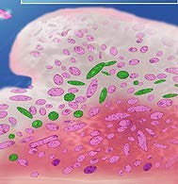
ULTRA STRUCTURE OF BIOFILM
Composed primarily of microbial cells and glycocalyx like matrix (Extracellular polymeric substance)
Fully developed biofilm is described as heterogeneous arrangement of microbial cells on a solid surface.
Basic structural unit of a biofilm is the microcolonies or cell cluster formed by the surface adherent bacterial cells.
  85% : - Matrix (polysaccharides, proteins, nucleic acid & salts)
  15% : - Bacterial cells
6

Slide 7

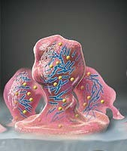
Viable, fully hydrated biofilm appears as ‘tower’ or ‘mushroom’ shaped structure adherent to the substrate .
Water channels : regarded as circulatory system in a biofilm : establish connection between microcolonies.
  Facilitates efficient exchange of materials between bacterial cells and bulk fluid :
    Coordinate functions in a biofilm community.
7

Slide 8

Matrix
A glycocalyx matrix made up of extracellular polymeric substance (EPS) surrounds the microcolonies and anchors the bacterial cell to the substrate.
Functions:
  Maintains the integrity of biofilms
  Prevents dessication
  Resists antimicrobial agents
  Create a nutritionally rich environment
  Acts as a buffer and retains extracellular enzymes

Slide 9

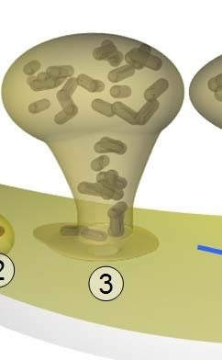
Slow bacterial growth enhance EPS production because EPS is highly hydrated, it prevents desiccation in some natural biofilms.
By maintaining a highly hydrated layer surrounding the biofilm, the EPS will prevent lethal desiccation in some natural biofilms and may thus protect against diurnal variations in humidity.
EPS : mechanical stability of the biofilms, enabling them to withstand considerable shear forces.
Studies : different organisms produce differing amounts of EPS and that the amount of EPS increases with age of the biofilm.
EPS may associate with metal ions, divalent cations, other macromolecules (such as proteins, DNA, lipids)

Slide 10
EPS production is known to be affected by
  Nutrient status of the growth medium
  Excess available carbon and limitation of nitrogen, potassium, or phosphate promote EPS synthesis
Bacterial cells within matrix produce Beta-lactamase against antibiotics
Also produce catalases and superoxide dismutase against oxidising ions of phagocytes
Elastases and cellulases produced by bacteria are concentrated in the matrix and produce tissue damage.

Slide 11
CHARACTERISTICS OF BIOFILM
Bacteria in the biofilm : unique capacity to survive tough growth and environmental conditions.
  Biofilm structure protects the residing bacteria from environmental threats.
  Structure of biofilm permits trapping of nutrients and metabolic cooperativity between resident cells of the same species and or different species.
  Biofilm structure displays organized internal compartmentalization.
  Bacterial cells in a biofilm community may communicate and exchange genetic material to acquire new traits.

Slide 12
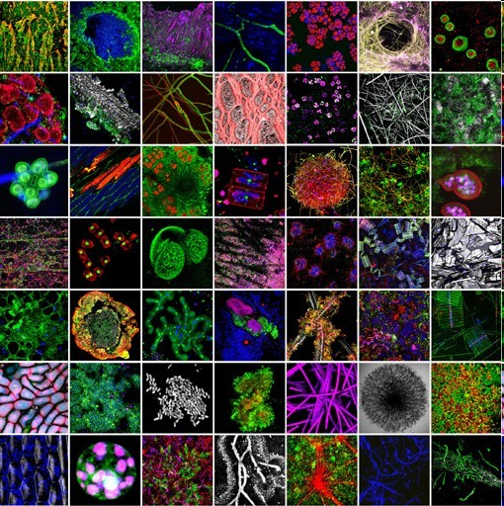
Biofilms everyw
here
They're everywhere:
on your shower curtain,
on medical devices
implanted in patients,
on rocks
in rivers and streams,
in your nose
Dental plaque

Slide 13
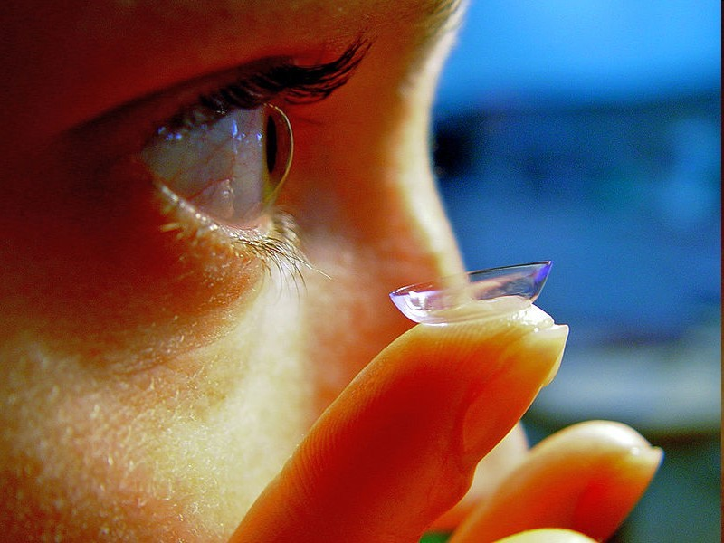
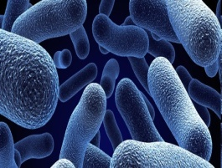
Biofilms and Cont
act lenses
Bacterial biofilm formation on contact lenses and contact lens storage cases may be a risk factor in contact lens- associated corneal infections.
Studies have shown that contamination of lens cases by bacteria, fungi, and amoebae is common with 20% to 80% of lens wearers having a contaminated lens case.
■

Slide 14
Urinary catheters and Biofilms
Urinary catheters are tubular latex or silicone devices, which when inserted may readily acquire biofilms on the inner or outer surfaces.
The organisms commonly contaminating these devices and developing biofilms are S. epidermidis, Enterococcus faecalis, E.coli, Proteus mirabilis, P. aeruginosa, K. pneumoniae, and other gram-negative organisms.
The longer the urinary catheter remains in place, the greater the tendency of these organisms to develop biofilms and result in urinary tract infections.

Slide 15
DEVELOPMENT OF BIOFILM
Bacteria can form biofilm on any surface that is bathed in a nutrition containing fluid.
3 major components involved in biofilm formation
  Bacterial cells
  A solid surface
  A fluid medium
Influenced by the physicochemical properties of the components involved in the biofilm.

Slide 16

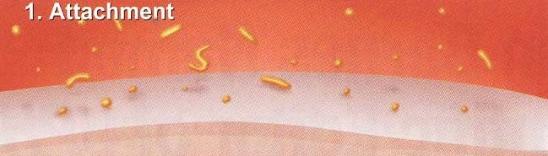
STAGE 1
Adsorption of inorganic and organic molecules to the solid surface, forming a thin layer termed as conditioning layer.
During dental plaque formation, the tooth surface is conditioned by the saliva pellicle.

Slide 17

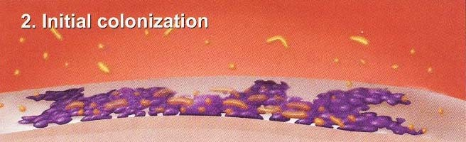
STAGE 2
Adhesion of microbial cells to this layer.
  Phase 1 - Transport of microbes to surface.
Phase 2
Phase 3
Initial non specific microbial-substrate adherence phase.
Specific microbial-substrate adherence phase.
Pioneer organisms : streptococci (major population)

Slide 18
STAGE 2 : Phase 1 : Transport of microbes to surface
Several factors that affect bacterial attachment to a solid substrate.
  ph
  Temperature
  Surface energy of the substrate
  Flow rate of the fluid passing over the surface
  Nutrient availability
  Length of time the bacteria is in contact with the surface
  Bacterial growth stage
  Bacterial cell surface charge
  Surface hydrophobicity.

Slide 19
STAGE 2 : Phase 1 : Transport of microbes to surface
Physicochemical properties such as surface energy and charge density determine the nature of initial bacteria-substrate interaction
Microbial adherence to a substrate is also mediated by bacterial surface structures such as fimbriae, pili, flagella, and EPS (glycocalyx).
Bacterial surface structures form bridges between the bacteria and the conditioning film.

Slide 20
STAGE 2 : Phase 2 : Initial non specific microbial-substrate adherence phase
Bridges formed are a combination of
  Electrostatic attraction
  Covalent and hydrogen bonding
  Dipole interaction
  Hydrophobic interaction
Bacteria with surface structures:
  P. gingivalis, S. mitis, Streptococcus salivarius, P. intermedia, P. nigrescens, S. mutans and A. naeslundii

Slide 21

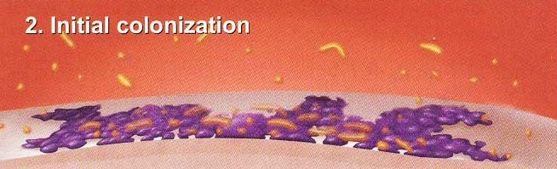
STAGE 2 : Phase 3 : Specific microbial-substrate adherence phase
Initial bonds : not strong
With time these bonds irreversible.
gains in strength, making the bacteria-substrate attachment
Finally, a specific bacterial adhesion with a substrate is produced via polysaccharide adhesin or ligand formation.
Adhesin or ligand on the bacterial cell surface will bind to receptors on the substrate.
Specific bacterial adhesion is less affected by many environmental factors such as electrolyte, pH, or temperature.

Slide 22
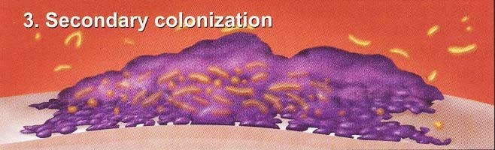
STAGE 3
Bacterial growth and expansion.
Monolayer of microbes attracts secondary colonizers forming microcolony, and the collection of microcolonies gives rise to the final structure of biofilm.
The lateral and vertical growth of indwellers gives rise to microcolonies similar to towers.

Slide 23

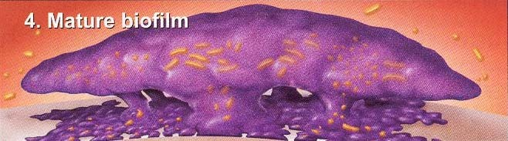
STAGE 3
A mature biofilm will be a metabolically active community of microorganisms where individuals share duties and benefits.
  Some microorganisms help in adhering to the solid support, while some others create bridges between different species
The bacterial cells in a matured biofilm will exhibit considerable variation in its genetic and biochemical constitutions compared to its planktonic counterparts.

Slide 24

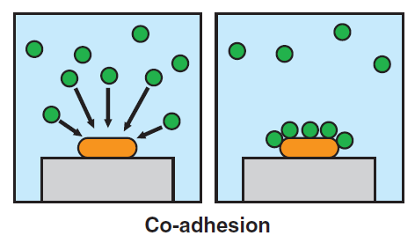

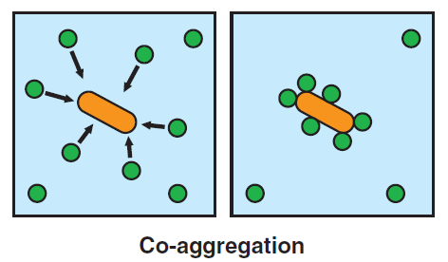
Two types of microbial interactions occur at the cellular level
Co-adhesion
  The process of recognition between a suspended cell and a cell already attached to substratum.
Co-Aggregation
  Genetically distinct cells in suspension recognize each other and clump together.

Slide 25

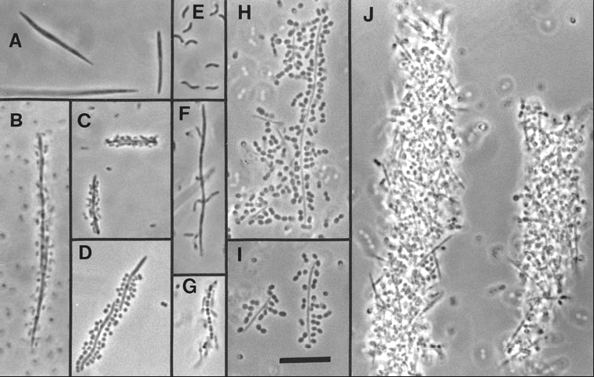

Slide 26

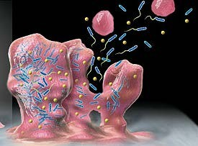
STAGE 4 : Detachment / Dispersion
During detachment, the biofilm transfer particulate constituents from the biofilm to the fluid bathing the biofilm.
Detachment plays an important role in shaping the morphological characteristics and structure of mature biofilm.
Also considered as an active dispersive mechanism
Because of flow effects, biofilm cells may be dispersed either by
  Shedding of daughter cells from actively growing cells
  Detachment as a result of nutrient levels
  Quorum sensing
  Shearing(cutting) of biofilm aggregates

Slide 27

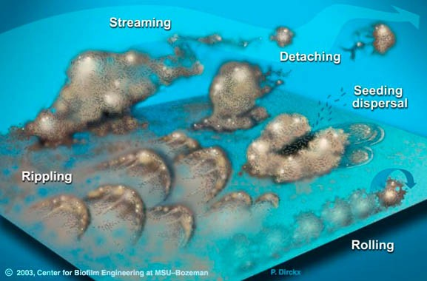

Slide 28
Protection of Biofilm Bacteria from Environmental Threats
Bacteria residing in a biofilm experiences certain degree of protection and homeostasis.
Bacteria are capable of producing polysaccharides, either as cell surface structures (eg. Capsules) or as extracellular excretions (eg. EPS).
EPS creates microniche.
  Protects from environmental stresses.
  Sequestration of metallic cations and toxins.
  Physically prevents diffusion of certain compounds by acting as ion exchanger.

Slide 29
Nutrient Trapping And Metabolic Cooperativity In A Biofilm
An important characteristics of biofilm growing in a nutrient deprived ecosystem is its ability to concentrate trace elements and nutrients by physical trapping or by electrostatic interaction.
Highly permeable and interconnected water channels provide an excellent means of material exchange.
The complex architecture of biofilm provides opportunity for metabolic cooperation and niches are formed within these spatially well-organized systems.
Juxta positioning of various microorganism provides cross feeding and metabolic cooperativity between different species.

Slide 30
EXCHANGE OF GENETIC MATERIAL
Bacterial biofilm provides a setting for the residing bacterial cells to communicate with each other.
The ability to communicate through quorum-sensing has been shown in some oral streptococci and some periodontal pathogens.
  For most oral biofilm micro-organisms,
    Presence and function of signal transduction pathways
    Quorum-sensing communication

Slide 31

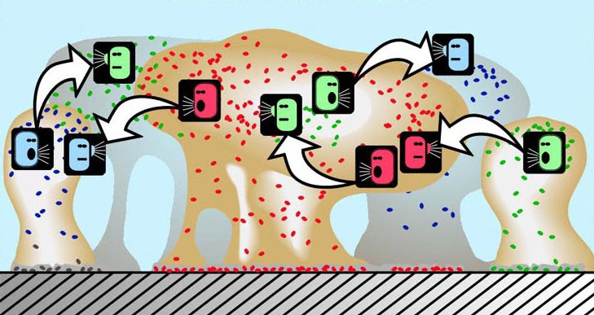
EXCHANGE OF GENETIC MATERIAL
Some of these signals produced by cells may also be interpreted by cells of different species by a process called quorum sensing.
Quorum sensing is mediated by low molecular weight molecules which in sufficient concentration can alter metabolic activity of neighboring cells and coordinates in the function of resident bacterial cells within a biofilm.

Slide 32
EXCHANGE OF GENETIC MATERIAL
Quorum sensing
  Involves the regulation of expression of specific genes through the accumulation of signaling compounds that mediate intercellular communication
Dependent on cell density and mediated through signaling compounds.
The signals are thought to allow cross-talk between species, causing them to increase their production of exopolysaccharide and the factors that increase their virulence.

Slide 33
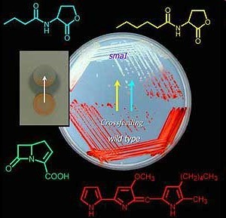
Biofilms –Quoru
m sensing
■
Certain species of bacteria communicate with each other within the biofilm. As their density increases, the organisms secrete low molecular weight molecules that signal when the population has reached a critical threshold. This process, called quorum sensing, is responsible for the expression of virulence factors.

Slide 34
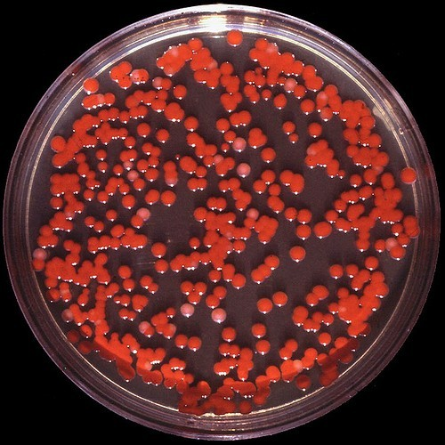
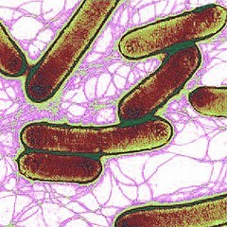
Quorum sensing helps the
of pathogens
survival

Slide 35

EXCHANGE OF GENETIC MATERIAL
Quorum sensing is involved in the regulation of
  Genetic competence
  Mating
  Bacteriocin production
  Sporulation
  Stress responses
  Virulence expression
  Biofilm formation
  Bioluminescence

Slide 36
Biofilms – Protects from Phagocytosis
Phagocytes are unable to effectively engulf a bacterium growing within a complex polysaccharide matrix attached to a solid surface.
This causes the phagocyte to release large amounts of pro- inflammatory enzymes and cytokines, leading to inflammation and destruction of nearby tissues.

Slide 37
Resistance of Microbes in the Biofilm to Antimicrobials
The nature of biofilm structure and physiological characteristics of resident microorganisms offer an inherent resistance to antimicrobial agents, such as antibiotics, disinfectants, or germicides.
Mechanism responsible for resistance:
  Resistance associated with extracellular polymeric matrix
  Resistance associated with growth rate and nutrient availability.
  Resistance associated with adoption of resistance phenotype.

Slide 38

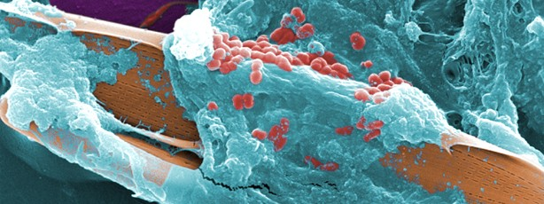
Benefits Of Biofilm To Microbes
Helps the bacteria to survive in unfavorable environmental and nutritional conditions.
Resistance to antimicrobial agents.
Increase in local concentration of nutrients.
Opportunity of genetic material exchange.
Ability to communicate between bacterial population of same and or different species.
Produce growth factors across species boundaries.

Slide 39

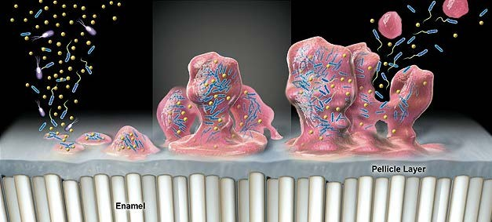
ORAL BIOFILMS
Oral bacteria have the capacity to form biofilms on distinct surfaces ranging from hard to soft tissues.
Oral biofilms are formed in three basic steps :
  Pellicle formation
  Bacterial colonization
  Biofilm maturation
Composition :
  80% : Water
  20% : Inorganic & organic (80% bacteria)

Slide 40
Organic : Carbohydrates, proteins, and lipids.
  Carbohydrates : produced by bacteria : glucans, fructans, or levans.
  Contribute to the adherence of microorganisms to each other and are the stored form of energy in biofilm bacteria.
  Proteins (supragingival biofilm) : derived from saliva
  Proteins (subgingival biofilm) : derived from gingival sulcular fluid.
  Lipid : Endotoxins (LPS) from Gram-negative bacteria.
Inorganic : Calcium, phosphorus, magnesium and fluoride.

