Slide 1
EXTREMOPHILES

Slide 2
ALKALIPHILES
These are extremophilic microorganisms which thrives in roughly alkaline environments (8-11), and have an optimum of pH around 10.
Organisms which needs high pH to survive are called as obligate alkaliphiles.
There are facultative alkaliphiles and haloalkaliphiles
(needs salty environment as well).
Most of the alkaliphiles possess a bacillus morphology.
Eg: Bacillus halodurans C125, Bacillus firmus OF4

Slide 3
Two methods for surviving
The cell will be having a unique cellular machinery that works best in alkaline range of pH.
The cell will have to acidify the cytosol to nullify
the effect of the high pH outside the cell.

Slide 4
Experimental studies revealed that the cytosolic enzymes of alkaliphiles functions best in a neutral pH range (7.5-8.5).
This shows that for surviving in highly alkaline pH, the cell must have some pH regulatory mechanism to protect the plasma membrane.
The mechanism is that the cell wall contains acidic polymers composed of residues such as galacturonic acid, gluconic acid, glutamic acid, aspartic acid, and phosphoric acid.
This protects the PM by preventing the entry of hydroxide ions and allowing the entry of sodium (Na⁺) and hydronium ions(H⁺)

Slide 5
XEROPHILES
A xerophile (from | Greek xēros | , meaning | "dry",
and philos, | meaning | "loving"), | is
an extremophilic organism that can grow and reproduce
in conditions with a low availability of water.
Water activity (a_{w}) is a measure of the amount of water within a substrate an organism can use to support sexual growth.
Xerophiles are often said to be "xerotolerant", meaning tolerant of dry conditions. They can survive in environments with water activity below 0.8.
Endoliths and halophiles are often xerotolerant.
Eg: many molds and yeast,
Trichosporonoides nigrescens

Slide 6
HALOPHILES
This group comprises microorganisms that can thrive in high salty environments such as The Great Salt Lake and Dead Sea.
Most of the halophiles belong to the Domain Archae.
Eg: Salinibacter ruber
There are eukaryotic halophiles such as Dunaliella salina (algae) and Wallemia icthyophaga (fungus).
Extreme halophiles/obligate halophiles-adapted to
survive high salt concentrations
Organisms from Dead Sea often requires nearly 33% salt (sea water has only 3%), and the inoculating loop must be dipped in a saturated salt solution to isolate them.
Microorganisms live in such high salinity are termed as extreme halophiles

Slide 7
Mechanism
Mainly employ two mechanism to prevent desiccation through osmosis.
Both strategies work by increasing the osmotic
concentration of the cell.
1.In first method (followed my most halophiles including bacteria, archae etc) organic compounds are accumulated in the cytoplasm.
They are known as osmoprotectants or compatible solutes.
It include sugars, aminoacids, polyols, betaines etc.
These compounds can be synthesised or accumulated from the environment.
Eg: Ectothiorhodospira halochloris

Slide 8
2. The second is the selective influx of potassium ions (K⁺) into the cytoplasm.
This adaptation is restricted to moderately halophilic organisms.
The entire intracellular machinery (enzymes, structural proteins etc) is highly adapted to withstand the high saline environment.
Eg: Bacteria comes under the Family
Halobacteriaceae
The 16S rRNA studies opens a broad range of information on the field of evolution.

Slide 9
ENDOLITHS
Endolith is an organism (archae, bacterium, fungus, lichen or algae) that lives in nutritionally poor environments such as inside a rock or something.
Particularly interesting in the area of astrobiology (exobiology).
These organisms opens a clue for life beyond earth. There are chances of having life on endolithic environments such as mars and other planets.

Slide 10
Characteristics
Endoliths have been found in rocks down to the depth of 3 km.
It is not known that whether this is the limit since digging to the deep is highly expensive.
The major threats to live in such depth is the high temperature.
Recently discovered strains can reproduce at 121⁰C.
All the discovered organisms are autotrophs.
Some utilize gas or dissolved nutrients from water moving through fractured rocks
Others may incorporate inorganic compounds found in their rock substrate (possibly by excreting acids to dissolve the rock).

Slide 11
Endoliths can be classified into
Chasmoendoliths
Colonizes fissures and cracks in the rock (chasmo- cleft)
Cryptoendolith
Colonizes structural cavities within porous rocks, including spaces produced and vacated by euendoliths (crypto = hidden)
Euendolith
Penetrates actively into the interior of rocks forming tunnels that conform with the shape of its body(eu = good, true).

Slide 12
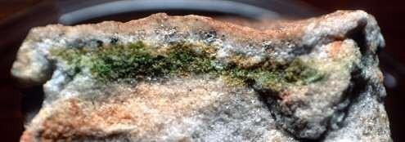
Endolithic life form found inside an Antarctic rock http://en.wikipedia.org/wiki/File:Cryptoendolith.jpghttp:// en.wikipedia.org/wiki/File:Cryptoendolith.jpg

Slide 13
Obligate Anaerobes
Microorganisms which grow strictly in the absence of molecular oxygen are called as obligate anaerobes.
For these, oxygen is a toxin
For energy generation, they must employ fermentation or anaerobic
respiration pathways.
The toxic forms of oxygen are Singlet Oxygen(O₂), Superoxide
radicals (O ⁻), peroxide anion (O ²⁻), and hydroxyl radical (OH).
2 2
Some obligate anaerobes are Clostridium spp, Methanococcus and
Methanopyrus
Microorganisms which can live both in the presence and absence of oxygen are known as Facultative Anaerobes.
They can utilize oxygen if available or, continue their growth by
fermentation and anaerobic respiration.
Eg: Bacillus anthracis, Escherichia coli

Slide 14
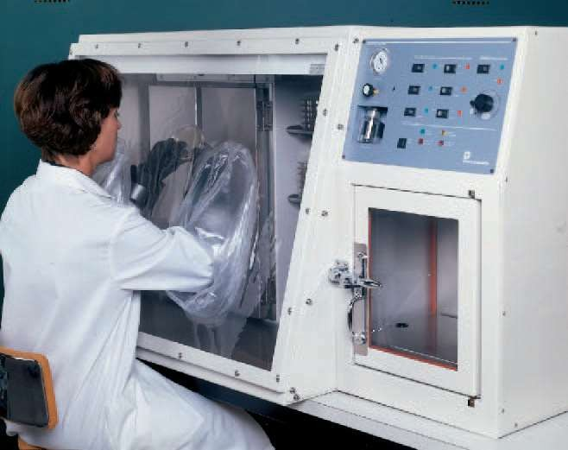
An anaerobic work chamber and incubator

Slide 15
To routinely grow and maintain in pure cultures, reducing media which stored in ordinary, tightly packed tubes is been used.( media containing thioglycollate or cystein)
For culturing in petriplates, sealed boxes and jars in which oxygen removed completely is been used.
Sometimes, certain chemicals which can produce hydrogen and carbon di oxide will be added and the so formed hydrogen will be incorporated with the oxygen present in the container to yield water
This water can be utilized by the microorganisms.
The most advanced system is that the media used for culture will be containing an enzyme- oxyrase which will bind with oxygen and eliminate as water. No addition of extra chemicals or hydrogen is needed.

Slide 16
Radiation
Although most living things are sensitive to radiation, there are some microorganisms which can resist high levels of radiation.
Deinococcus radiodurans is the radioresistant organism discovered so far which is a eubacteria.
Their ability to withstand radiation is more than that of
endospores.
They can survive exposure to radiation doses as high as 15,000 Grays. This much radiation is 1500 times the dosage that would kill a human.
The mechanism for this extraordinary resistance lies in a unique arrangement of its DNA that facilitates a rapid repair of radiation damage.
It is similarly resistant to many mutagenic chemicals.

Slide 17
Barophiles
Microorganisms that can survive under immense hydrostatic pressure.
Generally found in ocean floors where pressure exceeds
300 atm (38 MPa).
Some have been found at the bottom of the Pacific Ocean (Mariana Trench-10500 m) where pressure often exceeds 117 MPa.
These organisms cannot grow in pressure below 400-500
atm
True obligate barophiles also comprises bacteria which present in the gut of holothurians and amphipods (crustaceans).
Eg: Photobacterium, Shewanella, Colwellia
Some thermophilc archae such as Pyrococcus spp., Methanococcus jannaschii are barophiles too.

Slide 18
SOME INTERESTING FACTS
Halomonas titanicae- the bacterium which is responsible for rusting of RMS Titanic.
Pseudomonas putida (super bug) is
a genetically petroleum
engineered bacteria which literally “eats”
products. These are very much useful in oil spills.
GFAJ-1 is a strain of rod shaped bacteria
in the
family Halomonadaceae which is an extremophile, highly resistant to the dangerous poison-Arsenic.
There are chances of life forms beyond earth and the field of study is known as astrobiology.

Slide 19
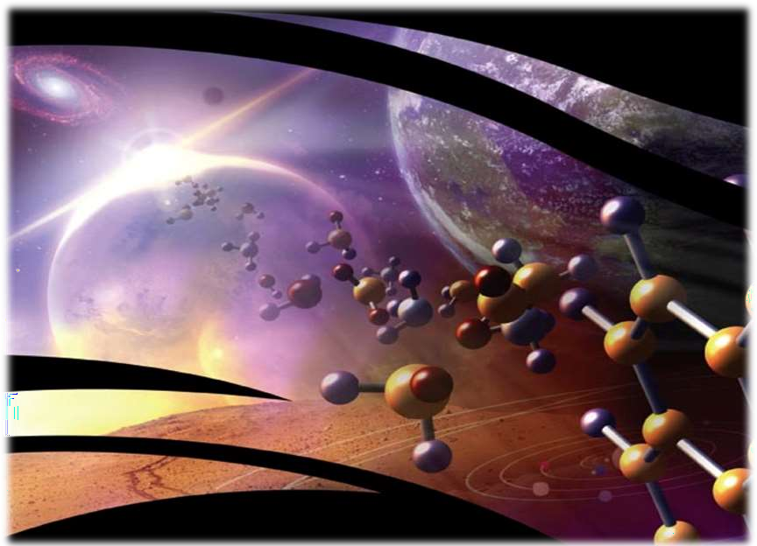
ASTROBIOLOGY/EXOBIOLOGY

Slide 20
The study of origin, evolution, distribution, and future of life in the universe and life forms that are extraterrestrial.
Astrobiology arises a question whether life exists beyond Earth and if so, how it can be detected by humans.
Nucleic acids might not be the only biomolecules which codes for life.
Astrobiology makes use of physics, chemistry, astronomy, biology, molecula r biology, ecology, planetary science, geography, and geology to investigate the possibility of life on other worlds and help recognize biosphere that might be different from the biosphere on Earth.

Slide 21
Recent advances in
planetary science have
changed fundamental possibility of life in the
assumptions
about the raising the
universe,
estimates of habitable zones around other stars
and the search for extraterrestrial microbial life.
The possibility that viruses might also exist
has been proposed. Efforts to
extraterrestrially
discover life on Mars, either currently or in the past,
is an active area of research.
Europa has emerged as one of the top locations in
hosting extraterrestrial life due to the presence of liquid water (somewhat an ocean).
the Solar | System | in | terms of potential
habitability | and | the | possibility of

